Slide 1
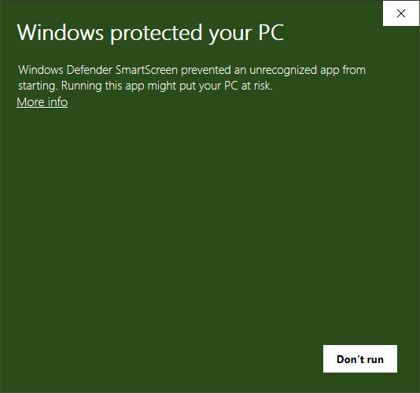
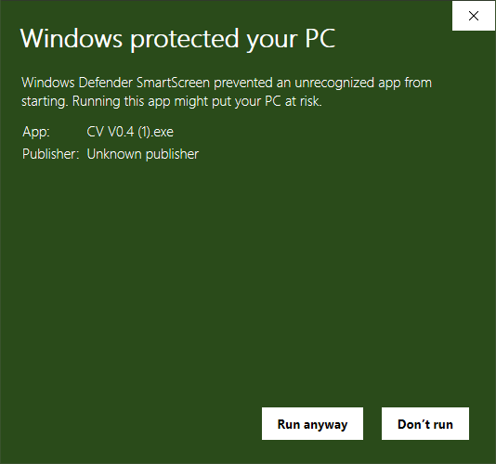
Windows defender Scherm 1
Windows defender Scherm 2
Klik hier
Deze optie verschijnt

Slide 2
Windows defender Screen 1
Windows defender Screen 2
click here
This option appears

Slide 3




Slide 4




